Slide 1
Simulation and optimization of the coupling efficiency from single-mode fibers to photonic waveguides
Buyu Xiao
Examinors: Prof.Dr.-Ing. Rolf Schuhlmann

Slide 2
Overview
Motivation and Objective
Project Introduction
Modelling
Optimization
Conclusion and Outlook

Slide 3
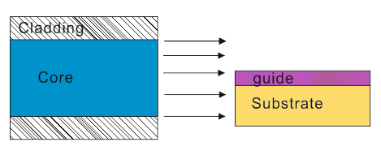

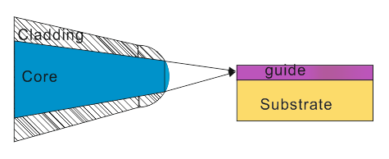
Motivation and Objective
Fiber-to-Chip
Motivation:
Fiber-to-Chip?
Coupling problems.
Tapered lensed Fiber.
Objective:
Analyzing different techniques to affect coupling efficiency.
Improving coupling efficiency.
Notes:
In integrated optic it is often to project light from optical fibers to photonic waveguides (so called Fiber-to-Chip).
As the signal source optical fibers have usually a larger end face than that of waveguides and the direct coupling from fibers to waveguides cause a very low coupling efficiency.
So tapered and lensed fibers (TLF) are applied to replace regualar fibers. Through TLF light power is confined in small range adapting to waveguide dimensions.
But it is not the only solution for promoting the coupling efficiency. There are more actions can be done for optimizing the coupling.
This work aim to analyze different techniques to affect the coupling from TLF to waveguide, and find out the optimal configurations. The caurse of light propagation can be divided in 3 tracks.The TLF handle the propagation at track 1. Following we talking about the optimal actions at track 2 and 3.

Slide 4
Overview
Motivation and Objective
Project Introduction
Modelling
Optimization
Conclusion and Outlook

Slide 5
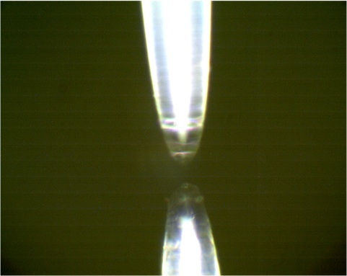
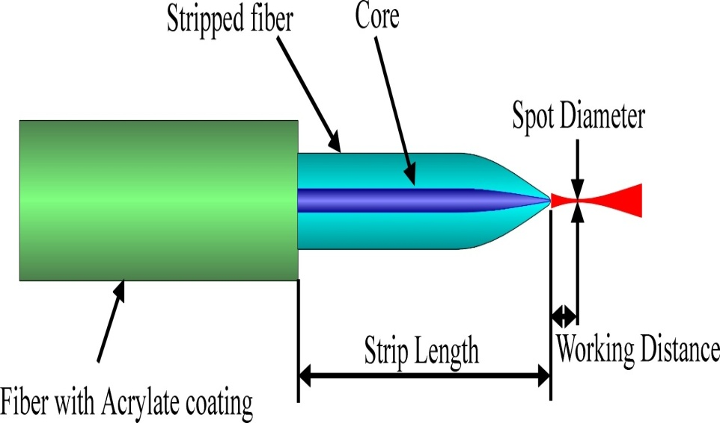
Project Introduction
Tapered Lensed Fiber
Parameters |  | Specifications(Single-mode)
Spot size | Minimum | 1.7µm(λ=1.5µm)
 |  | 0.6µm(λ=0.5µm)
 | Maximum | 6.0µm(λ=1.5µm)
Spot size Tolerence | Without near-field characterization | ±0.5µm
 | With near-field characterization | ±0.25µm
Working Distance | Minimum | 5µm (λ=1.5µm)
 | Maximum | 50µm (λ=1.5µm)
Additional : working distance 4µm(λ =1064nm)
Source:http://www.nanonics.co.il/lensed-fibers.html
Notes:
In last page we have shown the schema of coupling from TLF to waveguide.
The given TLF in the experimental setup is produced by NANONICS. It is fabricted by pulling and melting the regular fiber.
The top figure is the photography of the TLF. The figer right down is the schematic TLF.
The Table gives the technical detail of the TLF in experimental setup.

Slide 6
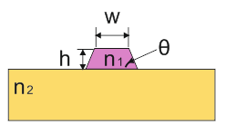
Project Introduction
Waveguide
Working wavelength :λ=1064nm
Waveguide: LiNbO3 with n1=2.516,
w≈1µm, h ≈ 0.5µm
Substrate: SiO2 with n2=1.544
Notes:
The waveguide in this experimental setup is a rib waveguide. The cross-section of the waveguide is a taper. The taper angle is very close to 90 grad. Therefore, the waveguide can approximate a rectangle.

Slide 7
Overview
Motivation and Objective
Project Introduction
Modelling
Optimization
Conclusion and Outlook

Slide 8
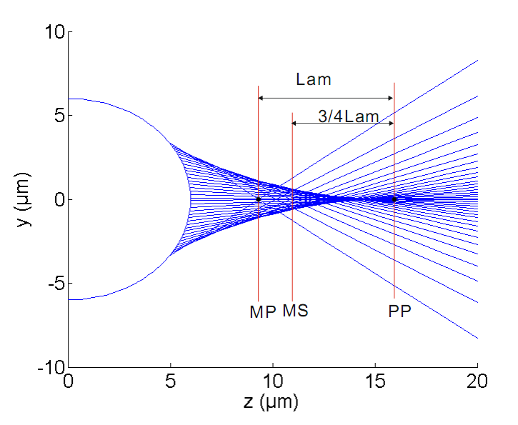
Modelling
Modelling TLF
Working distance:
minimum spot(MS)
Marginal plane(MP)
Paraxial focal plane(PP)
Logitudinal spherical
Aberration(LAm)
Notes:
In this work only the end part of the TLF is modelled. First step is to determine the lens. But the lens geometric parameters are not clearly given, so it can only be derived from its output properties in previous table. For the wide angle lens the minimum spot location(MS) is estimated by following method. The marginal ray has a focus at the optic axis. The plane through this focus is named Marginal plane(MP).The paraxial ray hits the optic axis at paraxial focus and the plane through it is called Paraxial focal plane(PP). The distance between MP and and PP is called longitudinal spherical aberration (LAm). Fromm PP backward ¾ LAm is the location of MS.

Slide 9
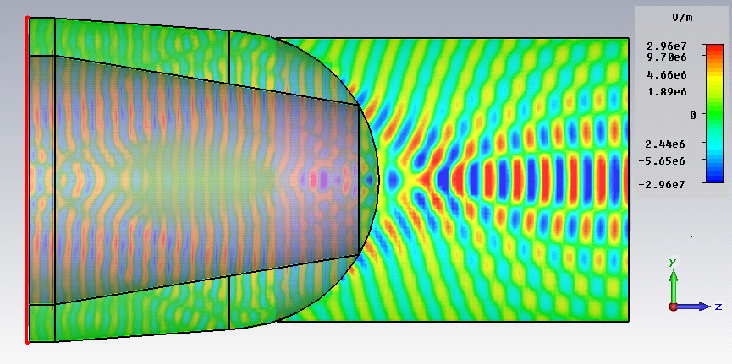
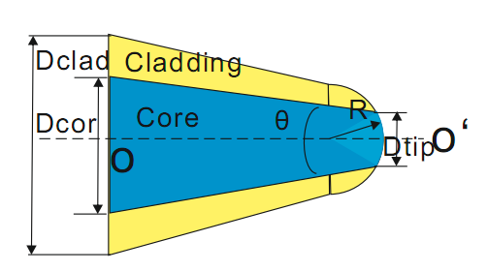
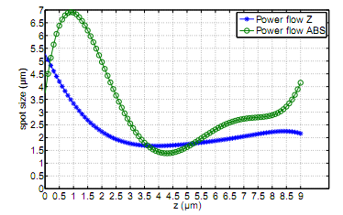
Modelling
Modelling TLF
 | 6
R(µm) | 6
ncore | 1.68
nclad | 1.66
Dclad(µm) | 17
Dcore(µm) | 10
Dtip(µm) | 6
Notes:
´Here we assume the lens end is a hemisphere radius of 6 µm. Through the estimation of working distance of previous page and we derivate the refractive index. The table give the parameters of TLF model in simulations.
The figure on right top is the screenshots of its E-field in logarithmic scale in yz-Plane. It can be seen that e-field is highly concentrated by TLF at a near distance.
The figure on right bottom shows the beam spot diameters through their absolute beam power flow density or its z-compents (propagation direction) of the beam power flow density along the propagation distance. The curve by absolute beam power flow density match the estimation of focal length in last page. We can also see the minimum spot diameter about 1.5µm.s

Slide 10
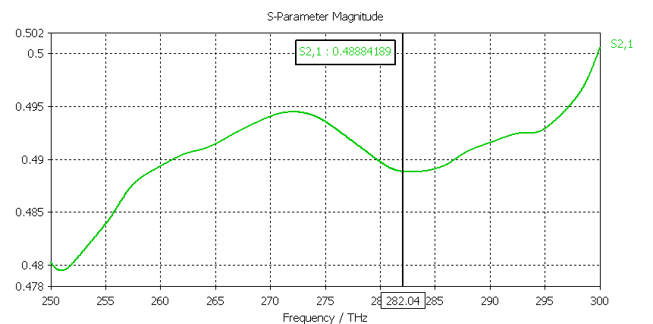
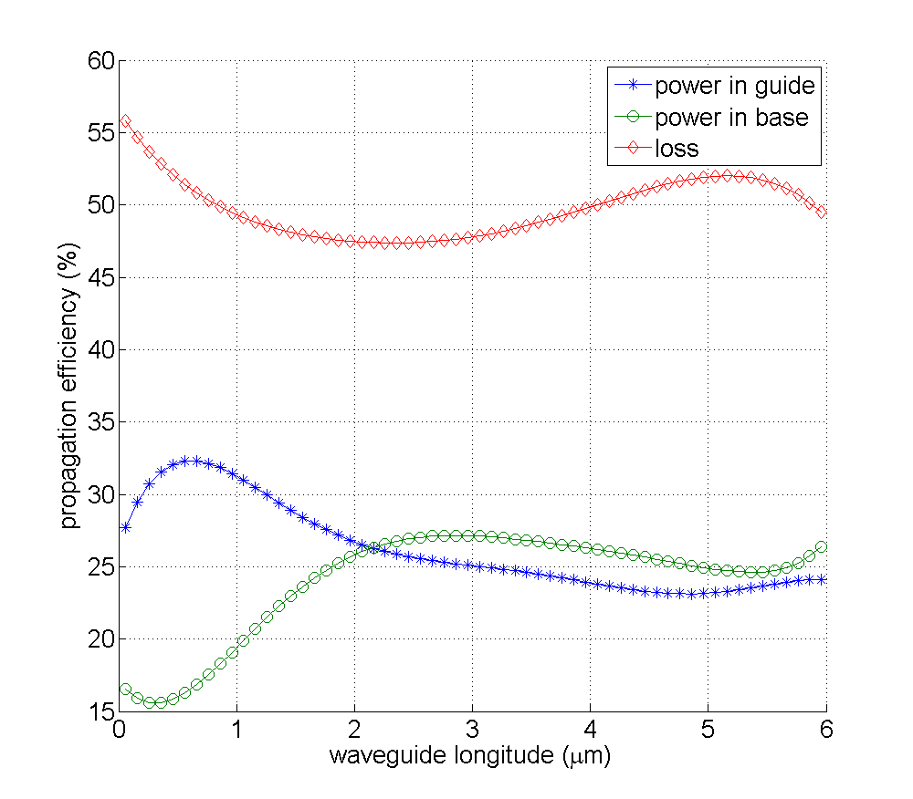
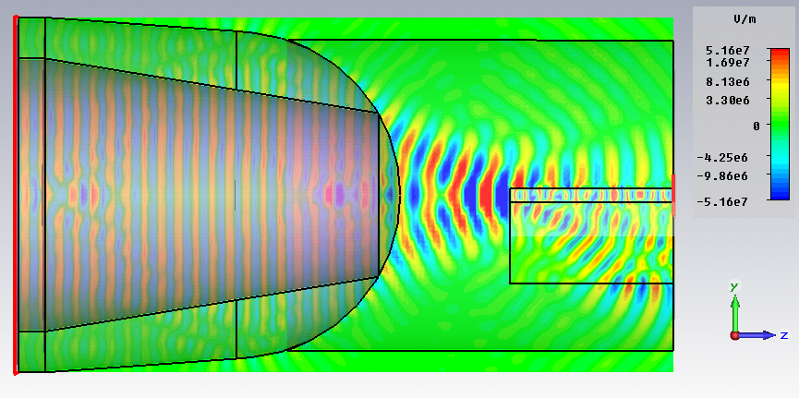
Modelling
Modelling fiber-to-chip-interfac
Coupling efficiency (S21) at working frequency
E-Field
Power distribution in section
Notes:
According previous works the TL- nd waveguide-model can be integrated, waveguide is located at working distance 4µm.
Firstly, it is the coupling efficiency of this integration in frequency domain, at 282THz with efficiency of 48.9%
The next figure shows the E-Field distribution of this configuration. It can be seen that the E-Field spreads more widely at the interface of the waveguide than that in the case without the waveguide and a great part of E-Field penetrates into the substrate rather than accepted by guide.
Then we can analyze the power distribution in this arrangement by executing the integral operation of power flow density over the cross-section of the waveguide. It can be seen about $40\%$ of the power propagates in the guide while another $40\%$ in the substrate and the rest is losing in the surrounding enviroment or reflected, etc.

Slide 11
Übersicht
Motivation and Objective
Project Introduction
Modelling
Optimization
Conclusion and Outlook

Slide 12
Optimization
Optimization tracks
Notes:
As previous demonstration, light propagation in fibe-to-chip-interface can be divied in 3 tracks.
TLF handle the first track to improving coupling ability by focusing the output light.
For following coupling actions, we deal with the light progation in 2nd and 3rd tracks.

Slide 13
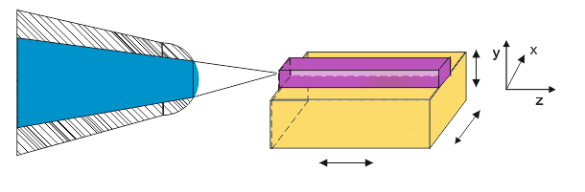
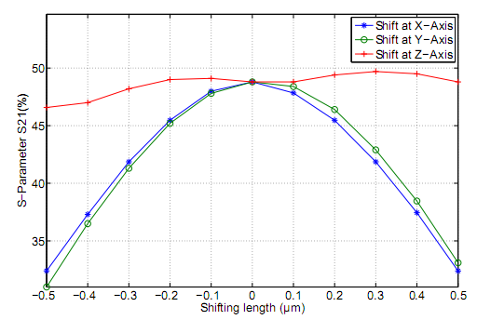
Optimization-Track2
Displacement of waveguide
Notes:
One thought is to displace the waveguide in x,y,z directions. In my work the displacement is confined in range of negative and positive 0.5µm.
Blue curve shows coupling behavior by displacing the waveguide along x-direction, green for y direction and red for z direction. It seems in x-and y-direction, the displacement cause the coupling efficiency falling quickly and in z-direction the displacement only leads to small change of the coupling ability.
Therefore, it can be summarized that waveguide should be located at the propagating center for the efficient coupling. In Z-direction we can keep it at the original working distance of 4µm.

Slide 14
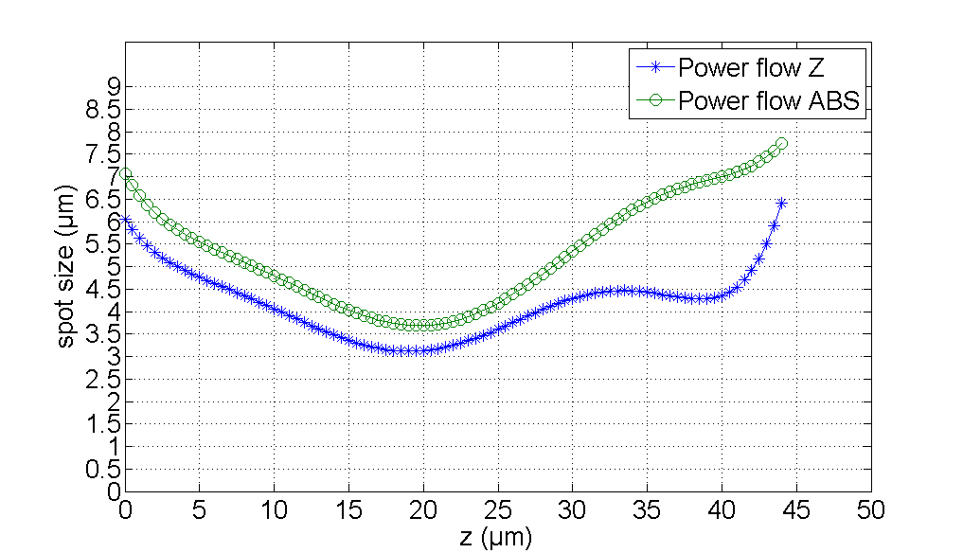
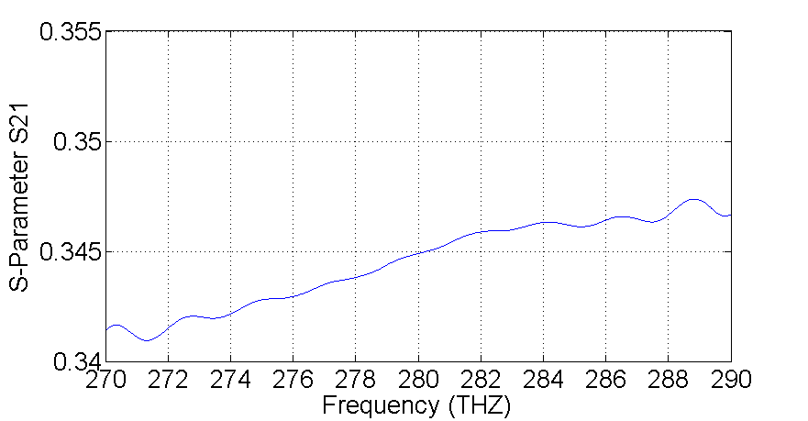
Optimization-Track2
Coupling in oil
n=1.526
Working distance 19µm
Notes:
Another idea for handling light propatation in track 2 is to replace the surrounding media. One possible media is oil with n= 1.526.
This change affects the location of minimum spot. It moves to 19µm from TLF end.
Coupling efficiency from the simulation falls to about 34.5% at 282THz.
His falling reavel that it is not proper replacement for air.

Slide 15
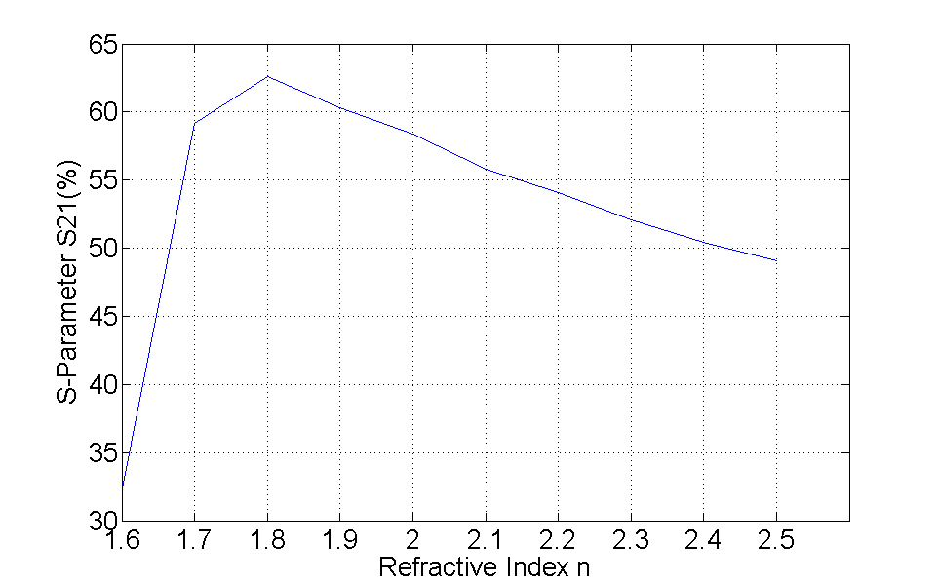
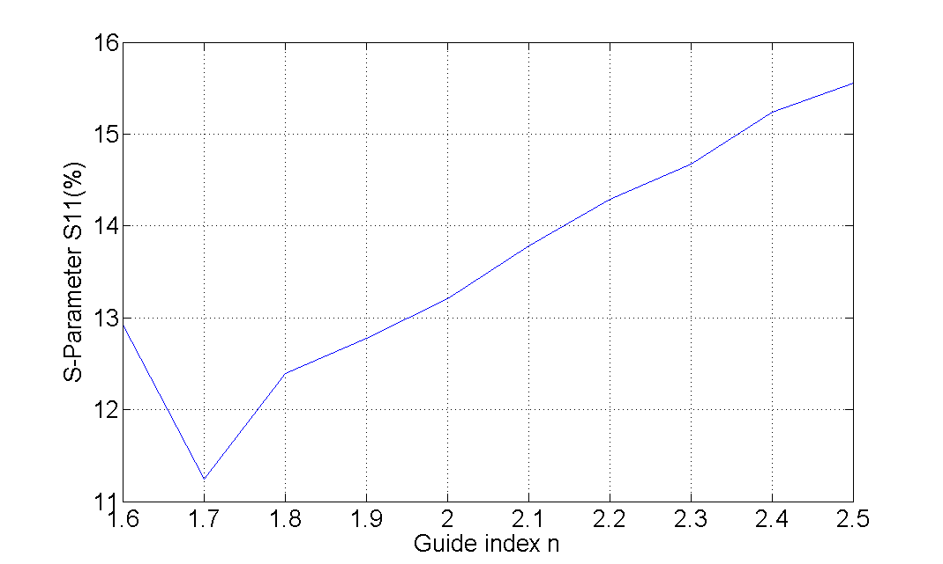
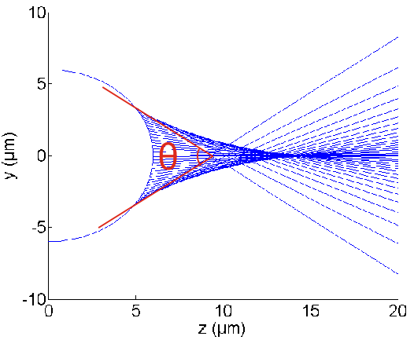
Optimization-Track3
Refractive Indices
Numerical Aperture (NA)
0.798(106°/2)
0.43(n=1.6)
0.711(n01.7)
0.925(n=1.8)
Reflection
Notes:
From this page we discuss the actions in track3.
Firstly we may want to investigate the effect of waveguide composition. In my simulations, the substrate is remained as original one. The guide material varied form n=1.6 to n=2.5.
The simulation result shows the n=1.8 is the optimal material for wavguide. His behavior can be explained in sections.
From 1.6 to 1.8 it is caused by NA changing. Through lens theory it can be calculated that light form given TLF is confined in a divergence angle of about 106 grad. In order to match the incident light, the minimal NA of the waveguide should be larger than 0.798. The value of NA is raised with the index increasing ,0.43 for n=1.6, 0.711 for n=1.7 and 0.925 for n=1.8.
When the index is still expanding other aspects become dominated. One aspect is the reflection at the end face. This figure collects the relation between reflection and indices.

Slide 16
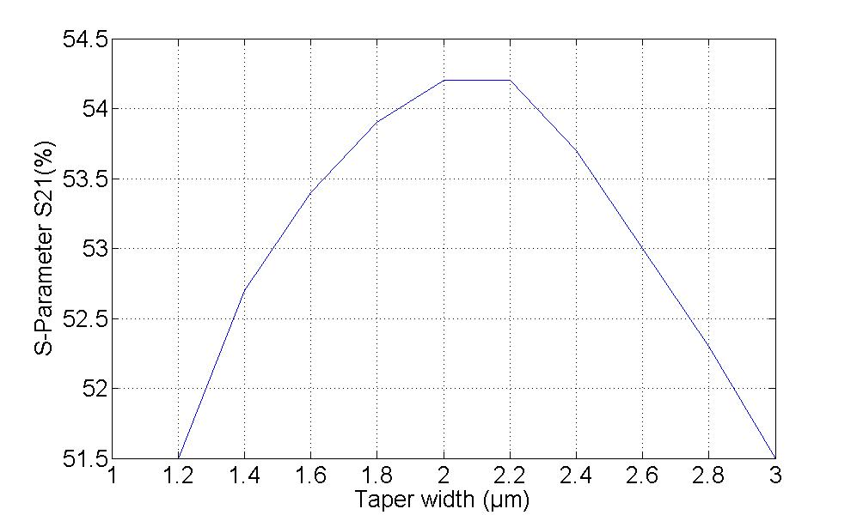
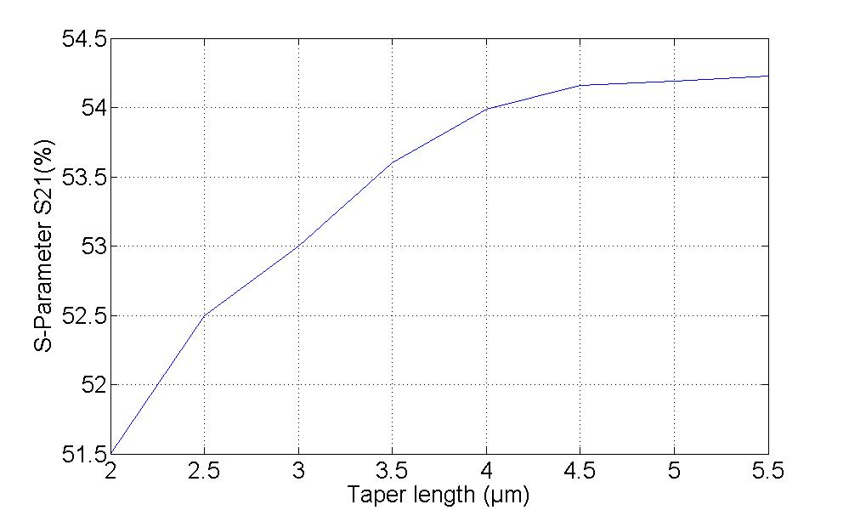
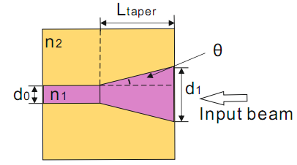
Optimization-Track3
Tapered Waveguide
What is a tapered waveguide
Coupling by varying taper width
Coupling by varying taper length
(Reason)
Notes:
In this page the taper structure is involved in waveguide for coupling.
This taper dimensions changes slightly along the longitudinal direction.
For simplification of the investigation, the effect of varying taper width and taper length was tested separately.
In testing width, the taper length is kept as constant of 5.5µm.
Coupling efficiency curve due to taper width reveal that taper width of 2-2.2µm is the best option. The reason is that wide taper interface can catch more linght ennergy. After 2.2µm, other aspects caus coupling decline.
In testing taper length, the taper width is kept as constant of 2µm.
Coupling efficiency curve due to taper length shows that long taper length leands to better coupling efficiency, but after length of 4.5µm there is no great improvement. The reason is mode conversion. In mode conversion the part of light energy is converted to high-order mode. The aspect ratio=length/width affects the mode conversion. Small length leads to small ratio, then cause great mode conversion. Big ratio limits the mode conversion.

Slide 17
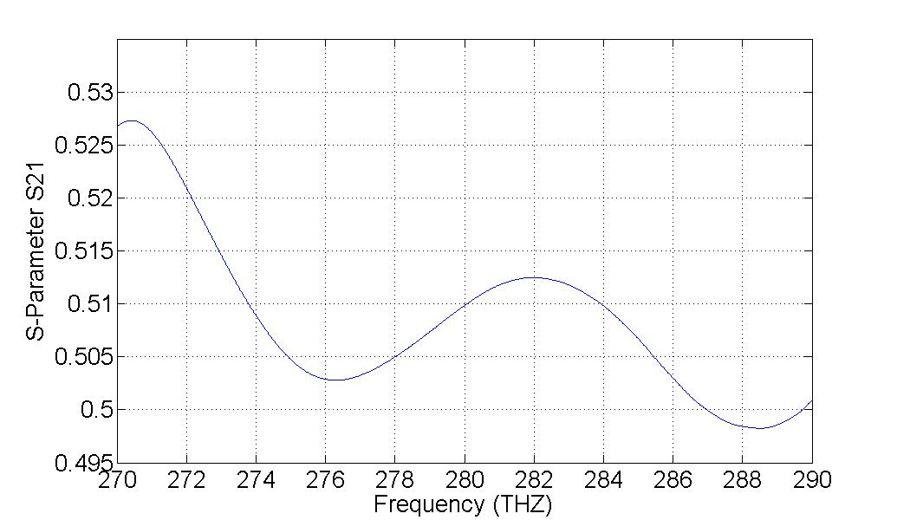
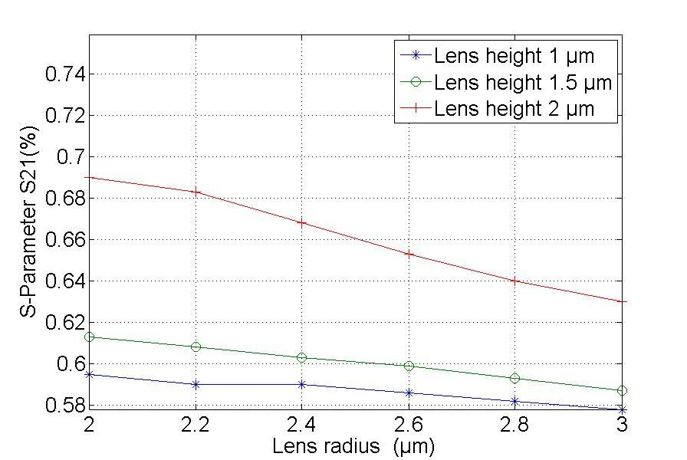
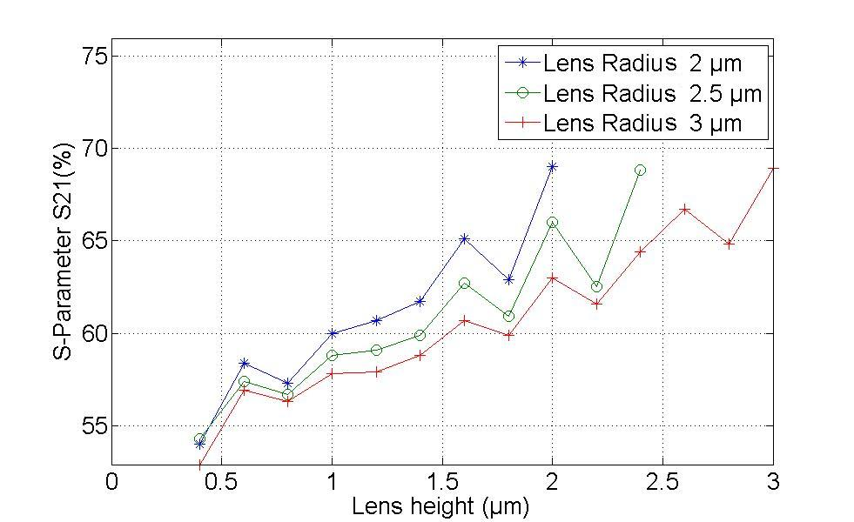
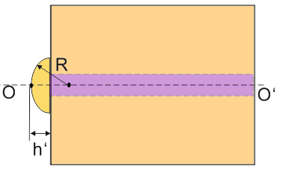
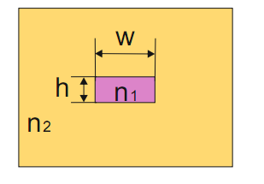
Optimization-Track3
Lensed Wavguide
Buried waveguide
Coupling efficiency due to lens height
Coupling efficiency due to lens radius
Notes:
Another important waveguide structure for efficient coupling is lensed waveguide. Lensed waveguide is fabricated by mounting a lens on the face of buried waveguide. Here the coupling TLF to buried waveguide is referred for following discussion. The buried waveguide in this work has same configuration as given rib waveguide, like n of waveguide and substrate, dimensions and location of waveguide. The coupling efficiency to buried waveguide at 282THz is about 51.3%. That is the reference value. In order to simplify the investigation of lensed waveguide, we test the effect of lens height and lens radius respectively.
For the test of lens hight, the radius is regraded as constant
The figure shows that longer lens height brings higher coupling efficiency.
For the test of lens radius, the height is constant.
It can be seen in the next figure that coupling efficiency falls with the lens radius increasing.
It can be summarized that the heimsphere lens structure is the best option.

Slide 18
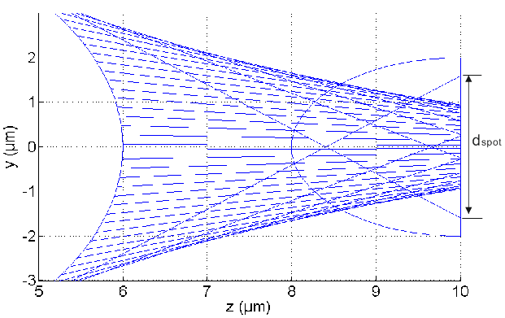
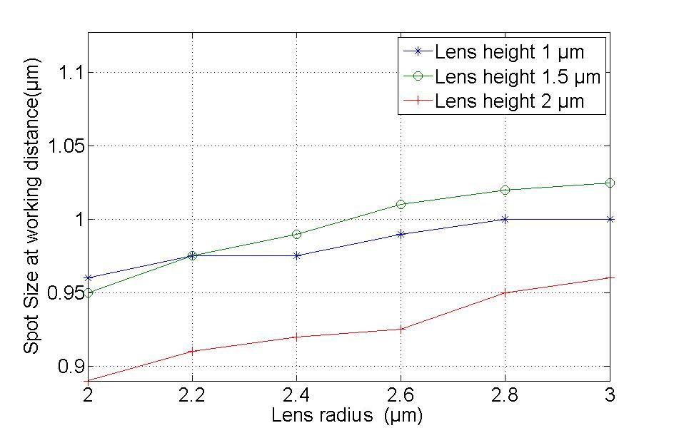
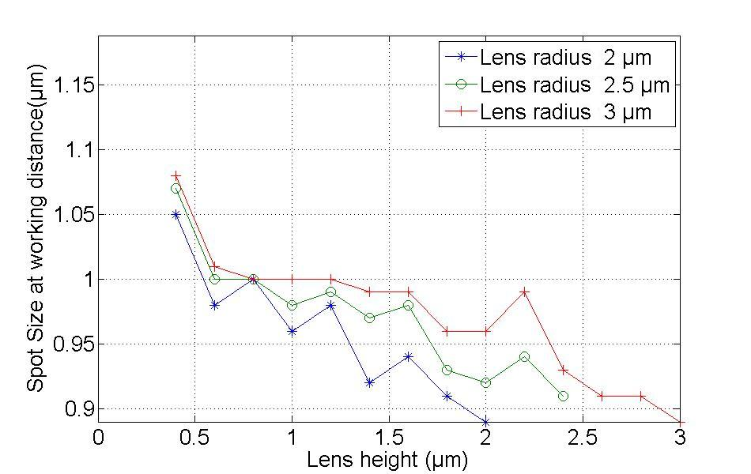
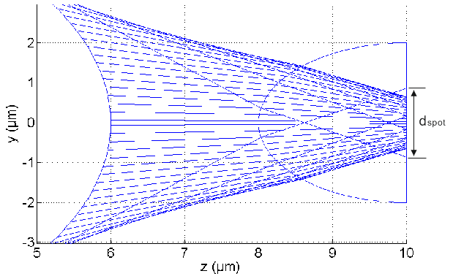
Optimization-Track3
Lensed waveguide
Spot Size
Without refractiion
Withrefractiion
Notes:
The term spot size can explains the effect of lens structure.
When the light from TLF reachs the waveguide end face, the light spot diameter dspot is about 2.4µm.
If the light is refrated by a heimsphere lens of radius 2µm and n=substrate, the the light spot diameter dspot at wqveguid end face is less than 2µm.
The post size curve correspond to simulations due to lens height and lens radius respectively.
The trend of of both spot size curve agree with the the coupling efficiency inversely

Slide 19
Overview
Motivation and Objective
Project Introduction
Modelling
Optimization
Conclusion and Outlook

Slide 20
Conclusion and Outlook
New refrative Index: about 62.6% for n = 1.8
Tapered waveguide: ratio = Ltaper/d1, 54%
Lensed waveguide: Hemisphere lens, 69%
Notes:
According previous discussion, the optimal actions for coupling are using new waveguide material, whose refractive index is about 1.8. This choice can raises the coupling efficiency to 62.6%
Although in this work, the coupling ability is not greatly improved by using taper structure.
Usinglensed structure is the best choice from this work, which achieves the efficiency of 69%.

Slide 21
Thank you
For your attention

Slide 22
Reference
1. C.W.BarnardandJ.W.Y.Lit,“Modetransformingpropertiesoftaperedsingle-
modeﬁbermicrolenses,” APPLIEDOPTICS.,vol.Vol.32,pp.2090–2094,
1993.
2. B.Z.L.Yang,D.X.DaiandS.L.He,“Characteristicanalysisoftaperedlens
ﬁbersforlightfocusingandbutt-couplingtoasiliconribwaveguide,” APPLIED OPTICS.,vol.Vol.48,pp.672–678,2009.
3. N.Burt,“Designandfabricationoftaperedwaveguidesin algaasforcoupling
lightinnanoscaleoptoelectronicdevices,” NNINREUResearchAccomplish-
ments,pp.28–29,2004.
4. P.L.-P.C.Alonso-Ramos,A.Ortega-MoñuxandR.Halir,“Efﬁcientﬁber-to-
chipgratingcouplerformicrometricsoiribwaveguides,” Opticsexpress,vol.
Vol.18,pp.15189–15200,July2010.
5. LensTheory,LASERCOMPONENTSLtd., http://www.lasercomponents.com/ﬁleadmin/userupload/home/Datasheets/lc/applikationsreport/lens-theory.pdf,April2011.
6. A.GhatakandK.Thyagarajan, OpticalWaveguidesandFibers,
http://spie.org/Documents/Publications/00%20STEP%20Module%2007.pdf,
April2011.

Slide 23
7. R.März, Integrated Optics.Artech House,1995.
8. R.Schuhmann, Script: Feldtheorie und Theoretische Elektrotechnik.Fachge-
bietTheoretische Elektrotechnik, University Paderborn, Apri 2009.
9. Gaussian Beam Optics 2,CVI Melles Griot,
http://www.cvimellesgriot.com/products/Documents/TechnicalGuide/Gaussian-
Beam-Optics.pdf, April2011, cVIMelles Griot Technical Guide.
10. T.Weiland,“Adiscretizationmethodforthesolutionofmaxwell’sequationsfor
six-componentﬁelds,” ElectronicsandCommunicationsAEUE,vol.Vol.31,
no.3,pp.116–120,1977.
11. U.RienenandT.Weiland,“Triangulardiscretizationmethodfortheevaluation
ofrf-ﬁeldsincylindricallysymmetriccavities,” IEEETransactionsonMagnet-
ics,vol.Vol.MAG-21,No.6,pp.2317–2320,1985.60 Bibliography
12. R.SchumannandT.Weiland,“Astableinterpolationtechniqueforfdtdon
nonorthogonalgrids,” InternationalJournalonNumericalModelling,vol.Vol.
11,pp.299–306,1998.
13. T.WeilandandR.Schuhmann, Script:ElektromagnetischeFeldsimulation.
FachgebietTheoretischeElektrotechnik,UniversityPaderborn.

Slide 24
M.ClemensandT.Weiland,“Discreteelectromagnismwiththeﬁniteintegra-
tiontechnique,” ProgressInElectromagneticsResearch,vol.PIER32,pp.
65–87,2001.
AgilentAN154S-ParameterDesign,AgilentTechnologies,
http://cp.literature.agilent.com/litweb/pdf/5952-1087.pdf,April2011,ap-
plicationNote.
S-ParameterHandout,UniversityofSanDiego,
http://home.sandiego.edu/ekim/e194rfs01/,April2011,eEE194RF.
LensedFibers,NanonicsImagingLtd.,http://www.nanonics.co.il/lensed-
ﬁbers.html,April2011,applicationNote.
A.S.DwariandS.Sanyal,“Analysisoflineartaperedwaveguide,” ProgressIn
ElectromagnicsResearch,vol.PIER64,pp.219–238,2006.
M.BelangerandG.L.Yip,“Modeconversionanalysisinasingle-modeplannar
taperopticalwaveguide,” AppliedScientiﬁcResearch,vol.Vol.41,pp.305–
314,1984.
A.P.EwoldVerhagenandL.Kuipers,“Nanofocusinginlaterallytaperedplas-
monicwaveguides,” Opticsexpress,vol.Vol.16,pp.45–57,January2008.

Slide 25
H.C.A.EdwardsandC.Dragone,“Idealmicrolensesforlasertoﬁbercou-
pling,” Journaloflightwavetechnology,vol.Vol.11,pp.252–257,1993.
K.I.K.Shiraishi,N.OyamaandS.Suga,“Aﬁberlenswithalongworkingdis-
tanceforintegratedcouplingbetweenlaserdiodesandsingle-modeﬁbers,”
Journaloflightwavetechnology,vol.Vol.13,pp.1736–1744,1995.
S.M.SASAKI,T.ANDOandK.HANE,“Directphotolithographyonopticalﬁber
end,” Jpn.J.Appl.Phys.,vol.Vol.41,pp.4350–4355,2002

Slide 26
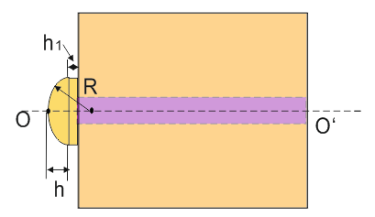
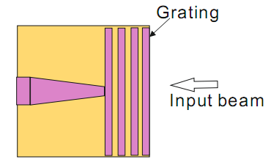
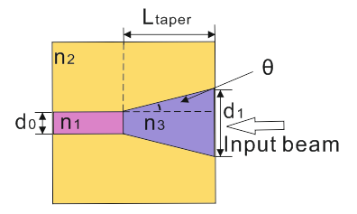
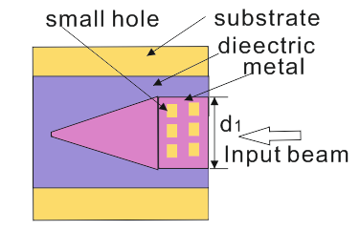
Optimization
Other optimal actions
Hybrid tapered waveguide:63%
Tapered plasmonic waveguide:??
Grating:65%
Lensed interface with neck: 72%
Notes:
There are also other waveguide structures for improving the fiber-to-chip coupling. Simulations shows that a hybrid tapered waveguide is possible to improve the coupling.
Tapered plasmonic waveguide
Grating
Lensed

